Slide 1
Team Epsilon
Team Members:
∙ Thomas Zachry ∙ Diane Chin ∙ Randy Thien Cao ∙ Charlie Pan ∙ Shayan Raza

Slide 2
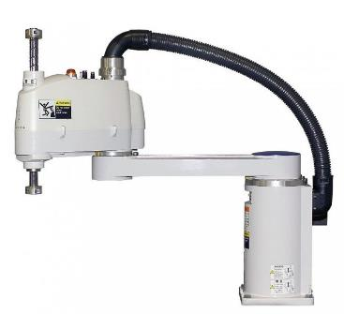
Project :
Scara Robot

Slide 3
PROGRESS
Project Charter Complete
Skeletal Design Locked in
Materials ordered
Design Process
Motors/Actuators research in progress

Slide 4
Sprint goals
System components research
Parts ordered
SCARA Process research
Project Requirements document
SCARA Kinematics
Skeletal Assembly
Ready to ship for powder coating

Slide 5
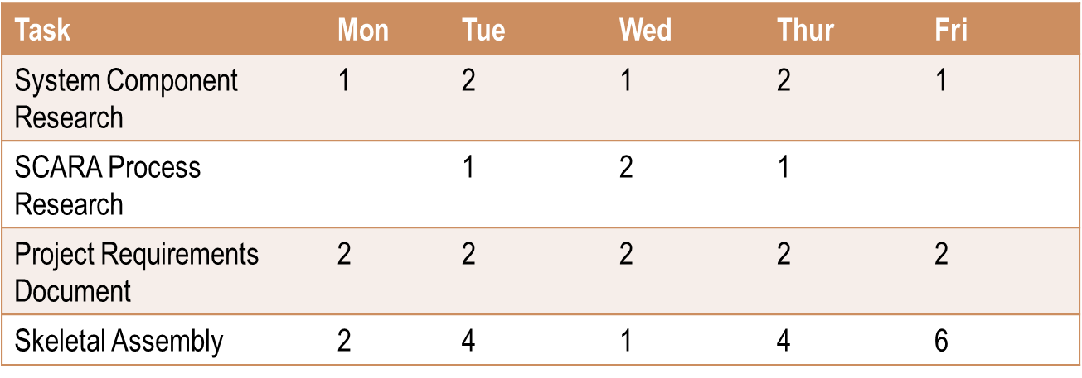
Sprint Backlog

